Slide 1


Banking ShowCase
All Banking Use Cases in One Place
Use Case Sheet
If you have any questions, please contact us:
mmiguelg@emeal.nttdata.com
cdelaosa@emeal.nttdata.com
asierras@emeal.nttdata.com

Slide 2
Index
1
Instructions for filling out a Use Case form
2
Example of a Use Case Template
3
Form Sections
4
Example Of a Completed Form

Slide 3





Index > Instructions for filling out a Use Case form
Section 1: General Information
Fill in general information about the use case such as title, summary, description, and contact information.
Section 2: Visual Resources
Attach the necessary resources or links that will be displayed in the use case template.
Section 3: Cataloguing and filtering cases
Check the corresponding boxes for your use case. This information will help categorize and compare your use case with the rest of the platform.
Section 4: Additional Information
You can represent additional information with one or more of the components in this section. They won't be used for filtering, only to add information to the use case template.
Translation section
Optionally, complete the general information and/or visual resources with a Spanish translation. Otherwise, a machine translation of only the general information will be performed.
Ensure that external links such as images, videos, or the use case demo itself are accessible at a minimum at the corporate level.
All information must be completed in English, except for the “Translations” section.
Boxes marked with (*) are mandatory.
Check that the image resolution is correct (minimum 1920x1080)
An example of the completed form is detailed on the last slide.

Slide 4
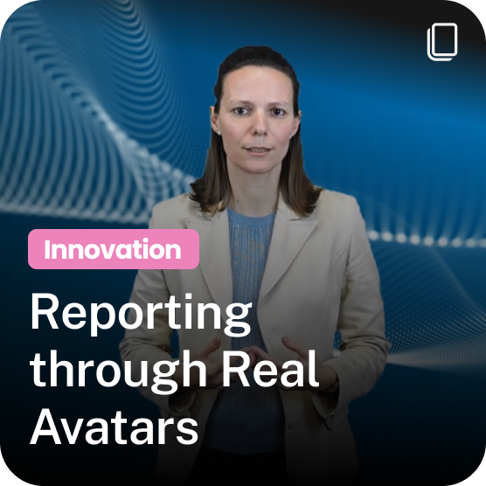
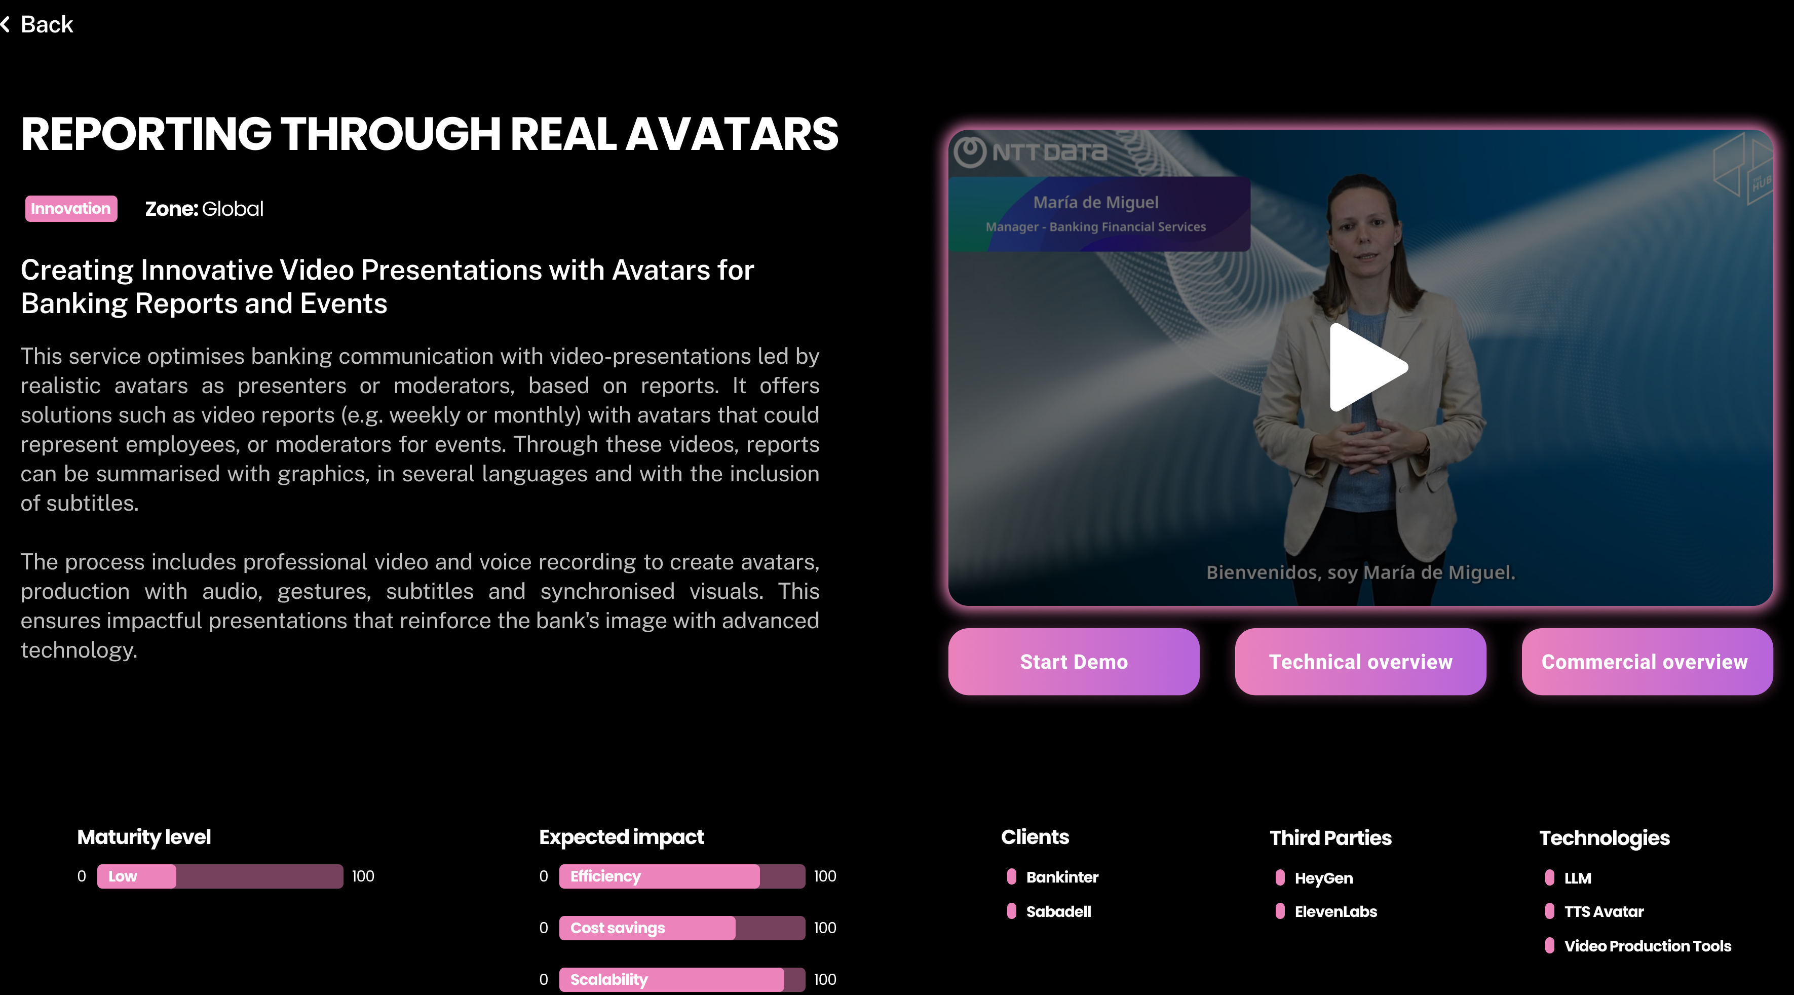
Index > Example of a Use Case Template
Preview
Title
Case Demostration Video
Use Case Area
Summary
Commercial overview
Overview of the use case
Technical overview
Applicable Geographic Area
Demo URL
Additional information

Slide 5

Index > Form Sections > SECTION 1 - GENERAL INFORMATION
The * represents a mandatory response.
USE CASE TITLE*
Use Case Summary*
(Máx. 60 Characters)
(Máx. 150 Characters)
Use Case Description*
Business Manager*
(Indicate full name and email address)
Technical Manager*
(Máx. 700 Characters)
(Indicate full name and email address)
You can see the representation of this data (in the form of an example) in slide 4

Slide 6


Slide 7


Index > Form Sections > SECTION 2 - VISUAL RESOURCES
The * represents a mandatory response.
Use case preview image*
Link to the video demo
(Attach a preview image or link of the use case)
(Optional) (Video link with minimum access at corporate level)
Link to demo
(Optional) (Demo link with minimum access at corporate level)
Technical overview
(Minimum at 1080x1080)
(Attach a document or image on the technical details of the use case)
Other images or resources
Commercial overview
(Optional)
(Attach a document or image of the business details of the use case)
You can see the representation of this data (in the form of an example) in slide 4

Slide 8







Index > Form Sections > SECTION 3 – CATALOGUING AND FILTERING CASES
Fill in the information by marking an 'X' as in the example:
Applicable Geographic Area *
BIAN Map*
Spain
Latam
Europe
Global
Business Processes Case Management
Lending
CRM
Risk
Payments & Transfer
International
Money Management
Connectivity with external systems
Business Foundations*
Structural & Support Functions
Regulatory Reporting
CIB
FRC
BFS
Compliance
Investment products & Distribution
Channels
Case Type*
Business Area per Foundation*
AI
Others
Corporate Banking
Capital Markets
Commercial
Development Stage*
Payments
Retail
Consumer Finance
Ideation
In Development
Asset &Wealth Management
Innovation
Pilot / MVP
Productive
Modernization
You can see the representation of this data (in the form of an example) in slide 4

Slide 9
Index > Form Sections > SECTION 4 - ADDITIONAL INFORMATION
This data appears in the use case tab but is not available for filtering.
Expected impact
Technologies used
Efficiency
Scalability
0 / 100
0 / 100
‎ ‎ ‎ ‎ ‎ ‎ ‎ ‎ ‎ ‎ ‎ ‎ ‎
‎ ‎ ‎ ‎ ‎ ‎ ‎ ‎ ‎ ‎ ‎ ‎ ‎ ‎
‎ ‎ ‎ ‎ ‎ ‎ ‎ ‎ ‎ ‎ ‎ ‎ ‎ ‎
‎ ‎ ‎ ‎ ‎ ‎ ‎ ‎ ‎ ‎ ‎ ‎ ‎ ‎
Cost savings
‎ ‎ ‎ 0 / 100
(Max. 4)
Maturity level
Third Parties
Low
Medium
High
‎ ‎ ‎ ‎ ‎ ‎ ‎ ‎ ‎ ‎ ‎ ‎ ‎ ‎
‎ ‎ ‎ ‎ ‎ ‎ ‎ ‎ ‎ ‎ ‎ ‎ ‎ ‎
‎ ‎ ‎ ‎ ‎ ‎ ‎ ‎ ‎ ‎ ‎ ‎ ‎ ‎
‎ ‎ ‎ ‎ ‎ ‎ ‎ ‎ ‎ ‎ ‎ ‎ ‎ ‎
(Max. 4. If not applicable, write N/A)
Clients
Customer Market Areas
‎ ‎ ‎ ‎ ‎ ‎ ‎ ‎ ‎ ‎ ‎ ‎ ‎ ‎
‎ ‎ ‎ ‎ ‎ ‎ ‎ ‎ ‎ ‎ ‎ ‎ ‎ ‎
‎ ‎ ‎ ‎ ‎ ‎ ‎ ‎ ‎ ‎ ‎ ‎ ‎ ‎
‎ ‎ ‎ ‎ ‎ ‎ ‎ ‎ ‎ ‎ ‎ ‎ ‎ ‎
(Max. 4. If not applicable, write N/A)
Indicates the customer areas involved in commercializing the use case.(Max. 70 Characters)
You can see the representation of this data (in the form of an example) in slide 4

Slide 10
Index > Form Sections > TRANSLATION SECTION (ESP)
Todos los apartados son opcionales.
Recuerda que, si estos campos no son completados, la traducción a castellano se hará de forma automática.
TITULO DEL CASO DE USO
Áreas comerciales del cliente
Indica las áreas del cliente involucradas en la comercialización del caso de uso (máx. 70 caracteres)
(Máx. 60 Caracteres)
Enlace al video de la demo en castellano
(Enlace de vídeo con acceso mínimo a nivel corporativo)
Descripción del caso de uso
Enlace a demo en castellano
(Máx. 700 Caracteres)
(Enlace a demo con acceso mínimo a nivel corporativo)
Ficha técnica
(Adjunta un documento o imagen de los detalles de negocio del caso de uso.)
Resumen del caso de uso
Ficha comercial
(Máx. 150 Caracteres)
(Adjunta un documento o imagen de los detalles técnicos del caso de uso.)
Puedes ver la representación de estos datos (a modo de ejemplo) en la diapositiva 4.

Slide 11
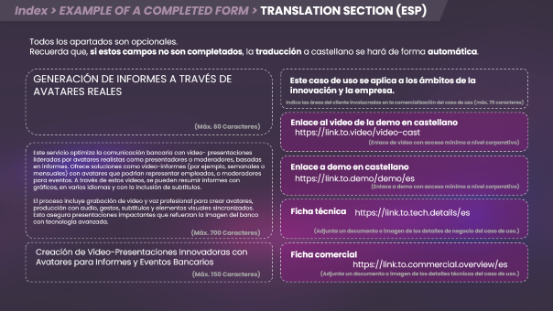
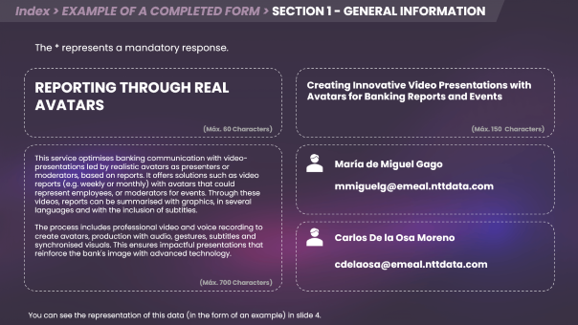
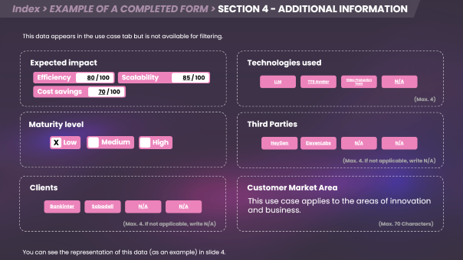
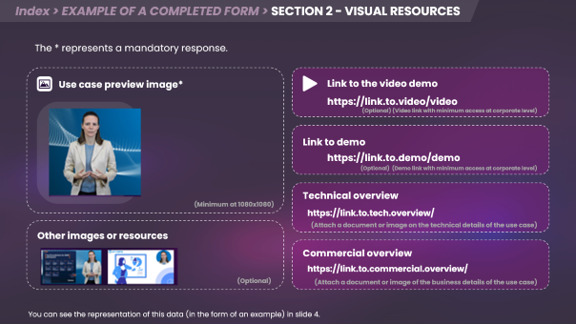
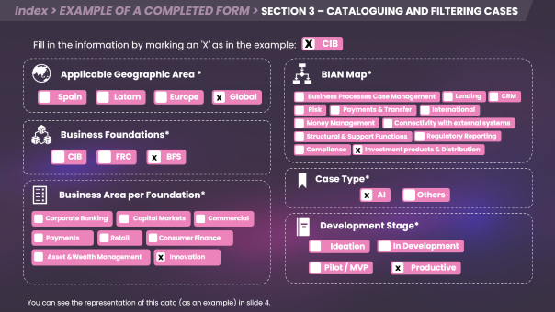
Index > EXAMPLE OF A COMPLETED FORM

Slide 12
Index > EXAMPLE OF A COMPLETED FORM > SECTION 1 - GENERAL INFORMATION
The * represents a mandatory response.
REPORTING THROUGH REAL AVATARS
Creating Innovative Video Presentations with Avatars for Banking Reports and Events
(Máx. 60 Characters)
(Máx. 150 Characters)
This service optimises banking communication with video-presentations led by realistic avatars as presenters or moderators, based on reports. It offers solutions such as video reports (e.g. weekly or monthly) with avatars that could represent employees, or moderators for events. Through these videos, reports can be summarised with graphics, in several languages and with the inclusion of subtitles.
The process includes professional video and voice recording to create avatars, production with audio, gestures, subtitles and synchronised visuals. This ensures impactful presentations that reinforce the bank's image with advanced technology.
María de Miguel Gago
mmiguelg@emeal.nttdata.com
Carlos De la Osa Moreno
cdelaosa@emeal.nttdata.com
(Máx. 700 Characters)
You can see the representation of this data (in the form of an example) in slide 4.

Slide 13
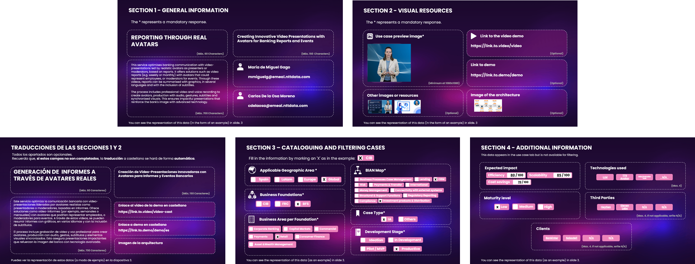
Index > EXAMPLE OF A COMPLETED FORM > SECTION 2 - VISUAL RESOURCES
The * represents a mandatory response.
Use case preview image*
Link to the video demo
https://link.to.video/video
(Optional) (Video link with minimum access at corporate level)
Link to demo
https://link.to.demo/demo
(Optional) (Demo link with minimum access at corporate level)
Technical overview
(Minimum at 1080x1080)
https://link.to.tech.overview/
(Attach a document or image on the technical details of the use case)
Other images or resources
Commercial overview
https://link.to.commercial.overview/
(Optional)
(Attach a document or image of the business details of the use case)
You can see the representation of this data (in the form of an example) in slide 4.

Slide 14
Index > EXAMPLE OF A COMPLETED FORM > SECTION 3 – CATALOGUING AND FILTERING CASES
x
Fill in the information by marking an 'X' as in the example:
CIB
Applicable Geographic Area *
BIAN Map*
Spain
Latam
Europe
Global
Business Processes Case Management
Lending
CRM
x
Risk
Payments & Transfer
International
Money Management
Connectivity with external systems
Business Foundations*
Structural & Support Functions
Regulatory Reporting
Compliance
Investment products & Distribution
CIB
FRC
BFS
x
x
Case Type*
Business Area per Foundation*
AI
Others
x
Corporate Banking
Capital Markets
Commercial
Development Stage*
Payments
Retail
Consumer Finance
Ideation
In Development
Asset &Wealth Management
Innovation
x
Pilot / MVP
Productive
x
You can see the representation of this data (as an example) in slide 4.

Slide 15
Index > EXAMPLE OF A COMPLETED FORM > SECTION 4 - ADDITIONAL INFORMATION
This data appears in the use case tab but is not available for filtering.
Expected impact
Technologies used
Efficiency
Scalability
80 / 100
85 / 100
LLM
TTS Avatar
Video Production Tools
N/A
Cost savings
‎ ‎ ‎ 70 / 100
(Max. 4)
Maturity level
Third Parties
Low
Medium
High
HeyGen
ElevenLabs
N/A
N/A
X
(Max. 4. If not applicable, write N/A)
Clients
Customer Market Area
This use case applies to the areas of innovation and business.
Bankinter
Sabadell
N/A
N/A
(Max. 4. If not applicable, write N/A)
(Max. 70 Characters)
You can see the representation of this data (as an example) in slide 4.

Slide 16
Index > EXAMPLE OF A COMPLETED FORM > TRANSLATION SECTION (ESP)
Todos los apartados son opcionales.
Recuerda que, si estos campos no son completados, la traducción a castellano se hará de forma automática.
GENERACIÓN DE INFORMES A TRAVÉS DE AVATARES REALES
Este caso de uso se aplica a los ámbitos de la innovación y la empresa.
Indica las áreas del cliente involucradas en la comercialización del caso de uso (máx. 70 caracteres)
(Máx. 60 Caracteres)
Enlace al video de la demo en castellano
https://link.to.video/video-cast
(Enlace de vídeo con acceso mínimo a nivel corporativo)
Este servicio optimiza la comunicación bancaria con video- presentaciones lideradas por avatares realistas como presentadores o moderadores, basadas en informes. Ofrece soluciones como video-informes (por ejemplo, semanales o mensuales) con avatares que podrían representar empleados, o moderadores para eventos. A través de estos videos, se pueden resumir informes con gráficos, en varios idiomas y con la inclusión de subtítulos.
El proceso incluye grabación de video y voz profesional para crear avatares, producción con audio, gestos, subtítulos y elementos visuales sincronizados. Esto asegura presentaciones impactantes que refuerzan la imagen del banco con tecnología avanzada.
Enlace a demo en castellano
https://link.to.demo/demo/es
(Enlace a demo con acceso mínimo a nivel corporativo)
Ficha técnica
https://link.to.tech.details/es
(Máx. 700 Caracteres)
(Adjunta un documento o imagen de los detalles de negocio del caso de uso.)
Creación de Video-Presentaciones Innovadoras con Avatares para Informes y Eventos Bancarios
Ficha comercial
https://link.to.commercial.overview/es
(Máx. 150 Caracteres)
(Adjunta un documento o imagen de los detalles técnicos del caso de uso.)

Slide 17
Thank you
for completing the form.
If you have any questions, please contact us:
mmiguelg@emeal.nttdata.com
cdelaosa@emeal.nttdata.com
asierras@emeal.nttdata.com

